Slide 1

Welcome to Year 5!

Slide 2

The Year 5 Team
Mrs Stiff
Mrs Bradshaw
Mrs Bainborough
Mrs Gardner

Slide 3
School Key Priorities
Mental health and wellbeing – inclusion and diversity
Writing – Talk for Writing
Teaching and Learning – metacognition and memory
Curriculum – consistency and assessment

Slide 4
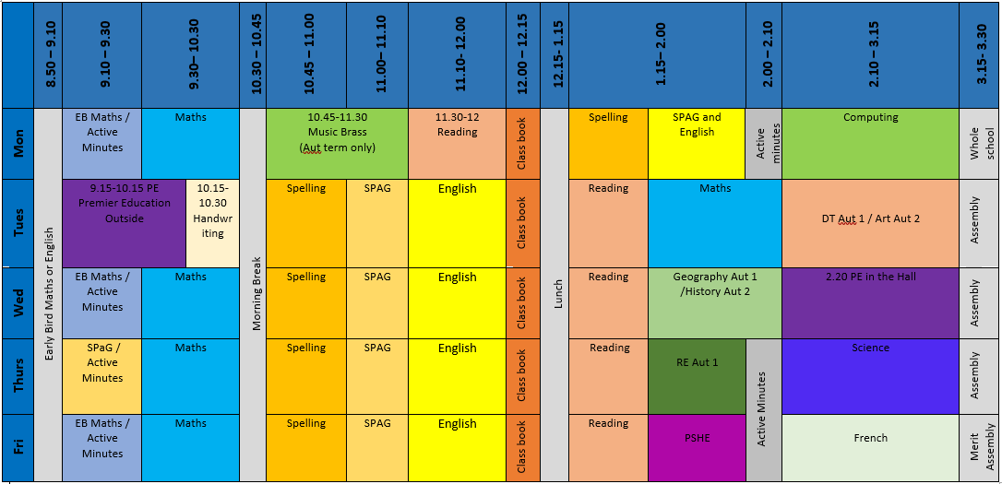
What does a typical day look like?

Slide 5
What do children need to bring to school every day?
School uniform (Monday, Thursday and Friday)
PE kits (Come in it on Tuesday and Wednesday)
Book Bags and/or backpack
Reading books and reading records
Homework (due in Wednesdays)
Water bottle
Snack – fruit only
Lunch box

Slide 6
School Uniform
Please label all removable items of clothing with your child's name
We believe that wearing school uniform encourages children to be proud of their school and helps to promote a positive attitude. Our uniform is as follows:
Grey trousers, skirt or pinafore dress and royal blue cardigan or sweatshirt (with logo)
White polo shirt
Baseball cap
Black shoes
In Summer, children may wear blue/white dresses.
Jewellery, other than a watch (no smart watches please) and stud earrings for pierced ears, should not be worn.

Slide 7
PE kit
Please label all jumpers with your child's name
Navy shorts, White T-shirt, and Trainers for some activities.
PE Kit should be worn to school on PE days (Tuesday and Wednesday)
Joggers and a jumper are advised for P.E. in winter.
For reasons of Health and Safety earrings should be removed for P.E. and swimming. The responsibility for this lies with you, the parents. Also for safety reasons, long hair should be tied back for PE lessons.
If your child is not able to do PE, please let the class teacher know, otherwise they will be asked to take part in their uniform.

Slide 8

New Merit Certificate System
One child from each class will receive a merit linked to one of our school values each week in a whole school assembly on a Friday. Following feedback from parents, parents will no longer be invited to this assembly.
One child from the class will receive a postcard home through the post – this will be a surprise! Hopefully it will arrive at the weekend.

Slide 9
Golden Rules
We listen and follow instructions
We speak respectfully to everyone
We take responsibility for property and equipment
We keep hands and feet to ourselves
We always have a go

Slide 10
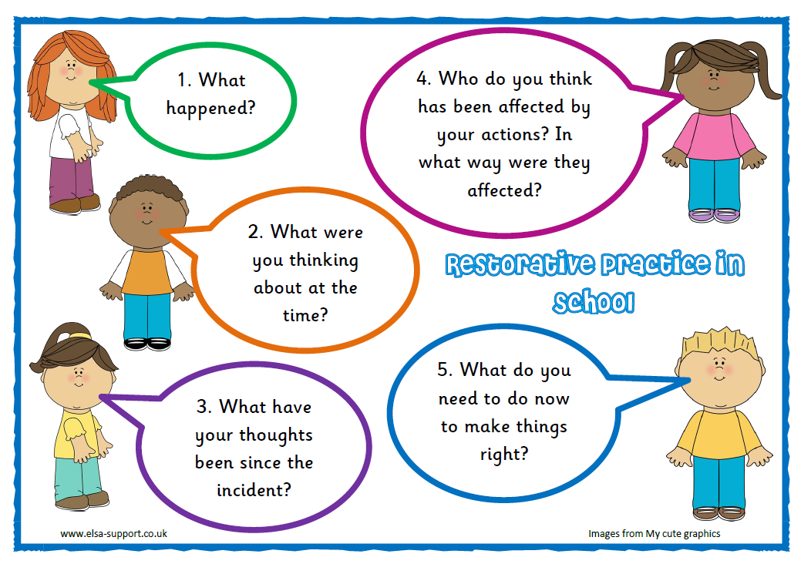
The Restorative Approach

Slide 11


Traffic Lights
Green

Slide 12


Gold Star

Slide 13

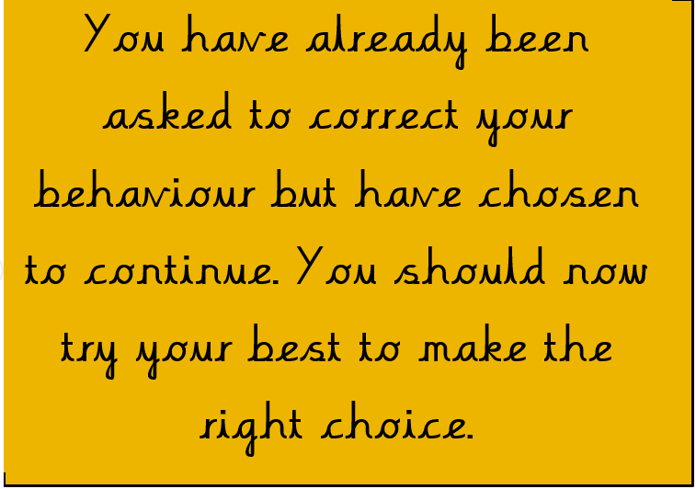
Amber

Slide 14

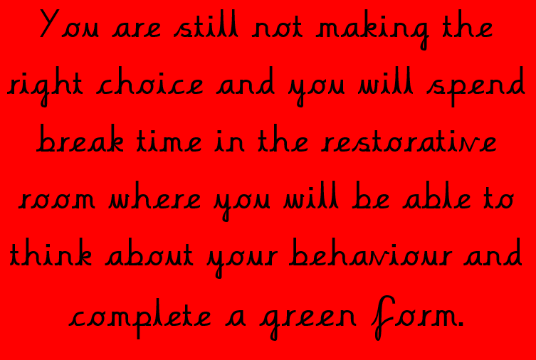
Red
You will be informed if you child has received a red
Notes:
Explain how the green forms give the children an opportunity to think about what they have done, who else may have been affected and how they might feel etc and think about how they can go about ‘restoring relationships’ and making things right again.

Slide 15

Class Dojo
Class Dojo captures and generates data on behaviour individually and as a whole class. We use the programme to give children positive behaviour feedback straight away that is visually fun
Your child will receive positive points. When they reach 50 positive they will earn their positive point prize.
Each week the class with the most positive points will earn a whole class prize.

Slide 16
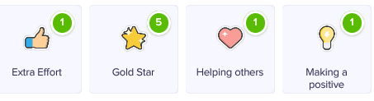
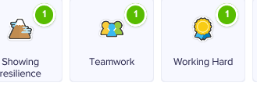
Class Dojo
Dojos will be given for school values as well as other positives, for example:

Slide 17
Homework
Given out on Friday, expected back on following Wednesday.
Spelling lists available on website class page are for information only
Reading
Personal spellings
Times Tables

Slide 18
Accelerated Reader – Home Connect
Enables parents to track their child’s overall progress from home. There is also access to AR Book Finder which helps you find books of interest and at the right level.
You can also check the levels of the books your child is reading at home and whether they are part of the reading scheme.
Please ask your class teacher for how to set this up, if you haven’t already.

Slide 19
Reading
Reading books – we expect all children to have a reading book in school every day. There will be regular opportunities for changing these depending on the reading level of the children.
Reading records – these are primarily for you to record the reading your child does at home. We may record information about school reading if we would like you to focus on something but otherwise we will write in to say they have changed their reading book or read with an adult outside of the class reading lessons.

Slide 20
Keeping in touch
School Website information including school calendar and latest news.
Class Pages for information about your child’s class
TheSchoolApp
School Twitter and Facebook – links on the website homepage.
https://twitter.com/MortonTrentside

Slide 21
The School App
Please note that we will be using TheSchoolApp for messages rather than Dojo. If you message on Dojo, this may not be seen or replied to.
Download TheSchoolApp
On the set up screen, search and add MTPS. Allow notifications
Notifications and message centre
Select which groups you want to receive notifications from. The main school group is mandatory and cannot be unsubscribed from.

Slide 22
Keep us updated please!
Inform teachers/TAs/admin – can be email – about who your child will be collected by if it is not who usually collects them.
Inform us if your child is to walk home alone.
Let us know of any change of phone number and email address.

Slide 23
Please don’t hesitate to contact me if you have any questions.
sophie.stiff@mortontrentside.lincs.sch.uk

