Slide 1

Parent Meeting Set 1 Sounds
Notes:
Approximately 20 minutes is needed for this session.
Notes are provided to help you lead the presentation.
Notes in italics are for your attention only.
This bitesize parent session is best used alongside a demo lesson of teaching a Set 1 sound to children. Alternatively, you may wish to use an in-action film from the Online subscription.
Provide copies of ‘Reading at Home Booklet 1’ from Oxford Owl for each parent.

Slide 2
Teach a child to read and keep that child reading and we will change everything.
And I mean everything.
Jeanette Winterson
Notes:
Read quote.
We want every Reception child to feel successful and know that they can achieve at school right from the start.
This means teaching them to read as early as possible.
Today I will explain how your child will learn to read sounds using the Read Write Inc. Phonics programme.

Slide 3









What is phonics?
Sounds (graphemes)
demonstrate, containing, roamed, trivial, injured, whimper
Notes:
All words are made up of individual sounds. These sounds are blended together to form words.
e.g. in ‘mat’ we have the sounds ‘m’, ‘a’, ‘t’, ship – ‘sh’, ‘i’, ‘p’.
A grapheme is another name for the letters we use to write the sound. It’s spelling of a sound on the page.
Using phonics, children learn to read by saying each sound and blending them to read a word.
Children learn to spell by segmenting a word into sounds and writing the matching graphemes.
The National Curriculum ensures that all children are taught Phonics systematically.
This gives your children the tools to read any word, for example demonstrate, containing, roamed, trivial, injured, whimper.

Slide 4


Some codes are easier than others
English
44 speech sounds
26 letters
150+ graphemes
Spanish
24 speech sounds
26 letters
29 graphemes
Notes:
We use 44 sounds to make all the words in the English language.
This means we’ve got a problem.
Click. We’ve got 44 speech sounds, only (click) 26 letters to write them,
The 26 letters work singly, in pairs and sometimes in threes to represent one sound.
We have to group letters together to write some sounds e.g. ‘igh’, ‘air’.
And (click) over 150 graphemes – 150 different ways to spell the sounds.
This makes our language one of the most complex in the world!
Most languages have a simpler code.
Take Spanish. Spanish has (click) 24 speech sounds, (click) 26 letters in their alphabet and (click) 29 graphemes. Neat.
N.B. It can be argued that Spanish has 27 letters due to the 'ñ', a letter that plays a key role in the pronunciation of many Spanish words.
Spanish children learn to read quickly.
Children learning to read in English have the odds stacked against them.
This means that we can’t leave anything to chance.
We teach a simple alphabetic code first (point to Simple SS chart) - as if English were Spanish.
First, we teach one grapheme to represent each of the 44 sounds.

Slide 5
The simple code: Set 1 and 2 sounds
Notes:
Read Write Inc, Phonics makes learning to read easy for children because we start by teaching them just one way of reading and writing every sound. Here they are on the Simple Speed Sounds chart.
We teach Set 1 sounds first - (sounds as far as a e i o u). Then Set 2 – one way to read and write each of the long vowel sounds.

Slide 6
The complex code: Set 3 sounds
Notes:
Then we teach children another way to read the sound, and then another until they can read the most common words in English. These are on the complex Speed Sounds Chart.

Slide 7
Speed Sounds Set 1
Notes:
Children need to know sounds – not letter names – to read words.
We say the sounds in a way to make them easy to blend into a word.
We aim to eliminate the ‘uh’ at the end of the sound. This is called a ‘schwa’ sound.
We say ‘c’ ‘a’ ‘t’ rather than cuh a tuh.
Use MTYT to teach each of the Set 1 sounds to parents.

Slide 8
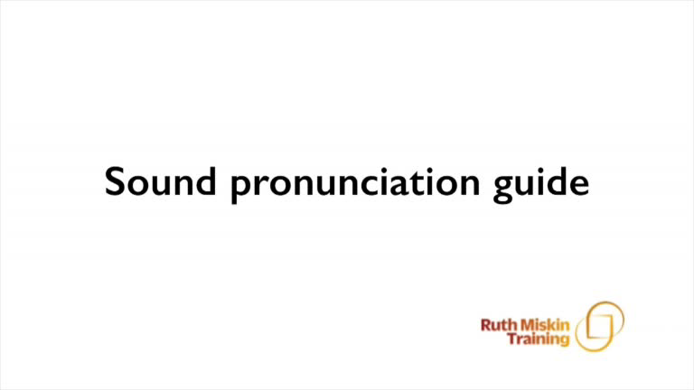
Pure Sounds (ruthmiskin.com)
Notes:
You can watch this film of little Sylvie on the Ruth Miskin website to practise using pure sounds. Play a little bit of the video.

Slide 9

Name the pictures
Notes:
We – children and adults - always connect new learning to something we already know.
This is why in Read Write Inc. we make the connections for the children. We help them hold onto that connection so they don’t forget at the end of each lesson.
We give children a hook to learn the sounds by using pictures in the same shape as the letter.
‘s’ looks like a snake.
‘d’ looks like a dinosaur.
‘m’ looks like a mountain.
‘a’ looks like an apple.
We teach the children to name the mnemonic pictures before they learn the sound.
This means that children learn to read and write the sounds really easily.

Slide 10





Teach something new…review, review review!
Notes:
We teach children to read and write a new sound each day.
We review the sounds we’ve taught before until they can read them speedily.

Slide 11



Speedy sounds + Fred = decoding
Notes:
Alongside teaching children sounds, we teach them to blend sounds to read words e.g. s-a-t, sat.
Once children can read sounds speedily, like this, (show how speedily this needs to be) and understand Fred (m-a-t...mat) (click), they can decode words.

Slide 12
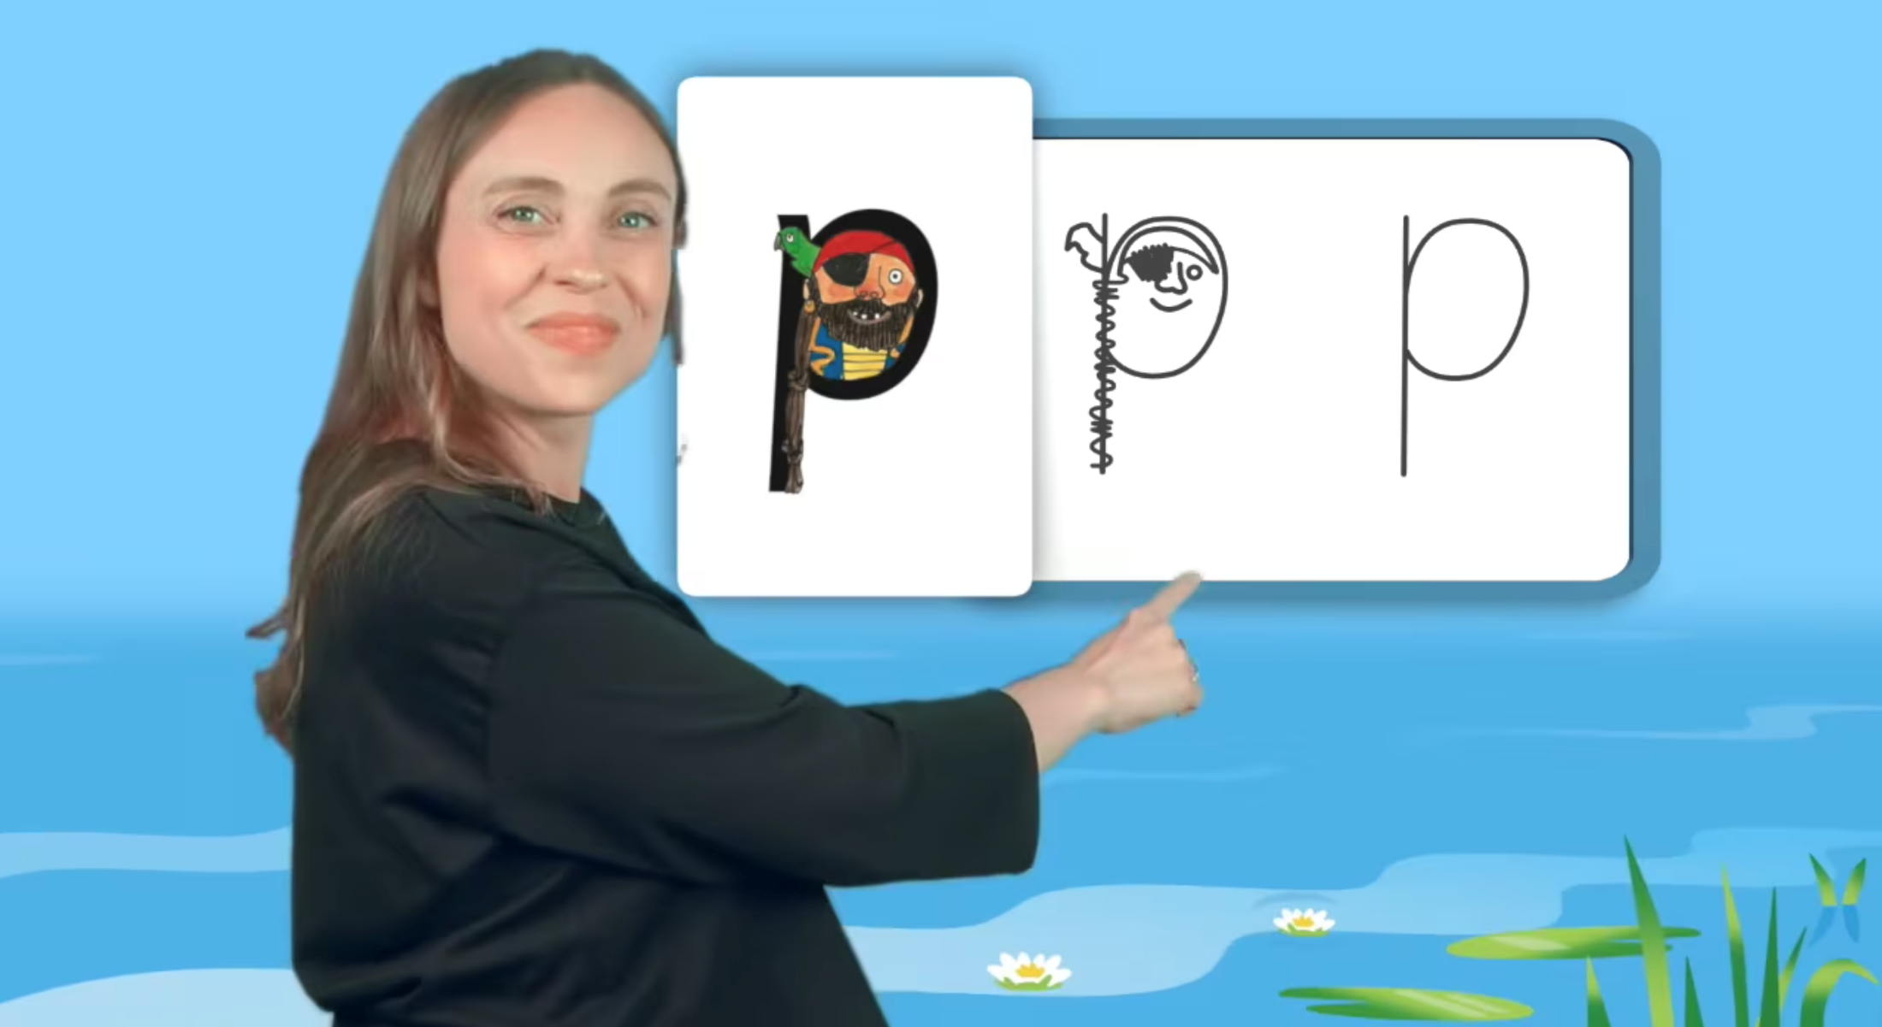
Virtual Classroom Set 1 sounds
Notes:
Each week, we will send home film links to lessons that match the Set 1 sounds your child has been learning in school.
Your child uses the Virtual Classroom in school.
Children are familiar with the VC teachers – and interact with them as they would their own teacher.
Watch these films with your child to help them to practise reading the sounds and writing the sounds.
Simply click the link and watch on a tablet or other device.
Let’s have a look at one of these films on the Virtual Classroom. Play a Set 1 at home film from the virtual classroom.

Slide 13
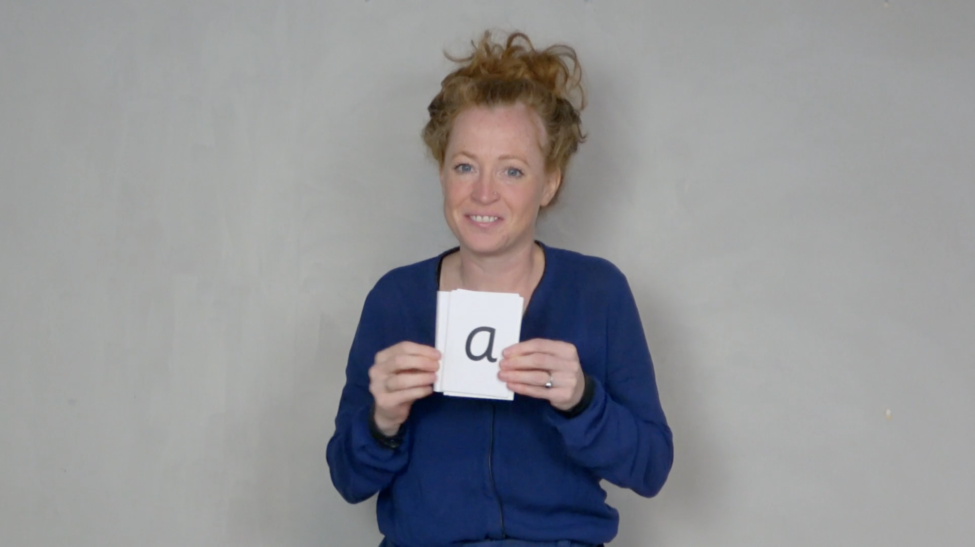
Virtual Classroom Pinny time
Notes:
We will also send home links to these 1 minute pinny time and speed minutes films to help your child to practise reading sounds speedily.

Slide 14
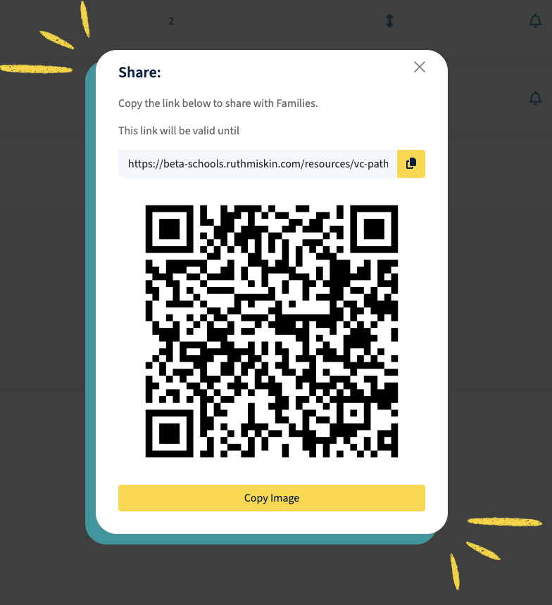
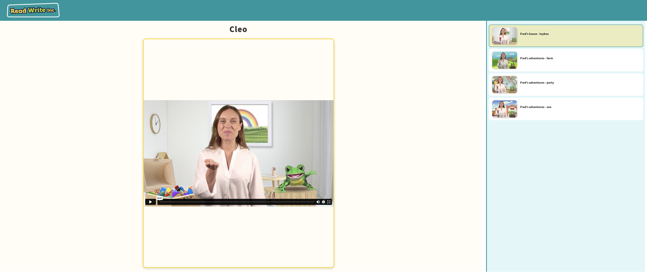
Pupil pathways

Slide 15

How do I use the Virtual Classroom?
Set aside 10 minutes to watch a film with your child each day.
Find a quiet space for your child to watch the film on a laptop or tablet.
Praise your child as they join in with the lesson – make it fun!
The more they practise using these films, the quicker they’ll learn to read.
Notes:
We will send you links to the films via email/ upload links to Google classroom/ Class Dojo etc.
When you receive the link, simply click on it . . . and press play.
Set aside 10 minutes to watch a film with your child each day.
Find a quiet space for your child to watch the film on a laptop or tablet.
Praise your child as they join in with the lesson – make it fun!
The more they practise using these films, the quicker they’ll learn to read.

Slide 16
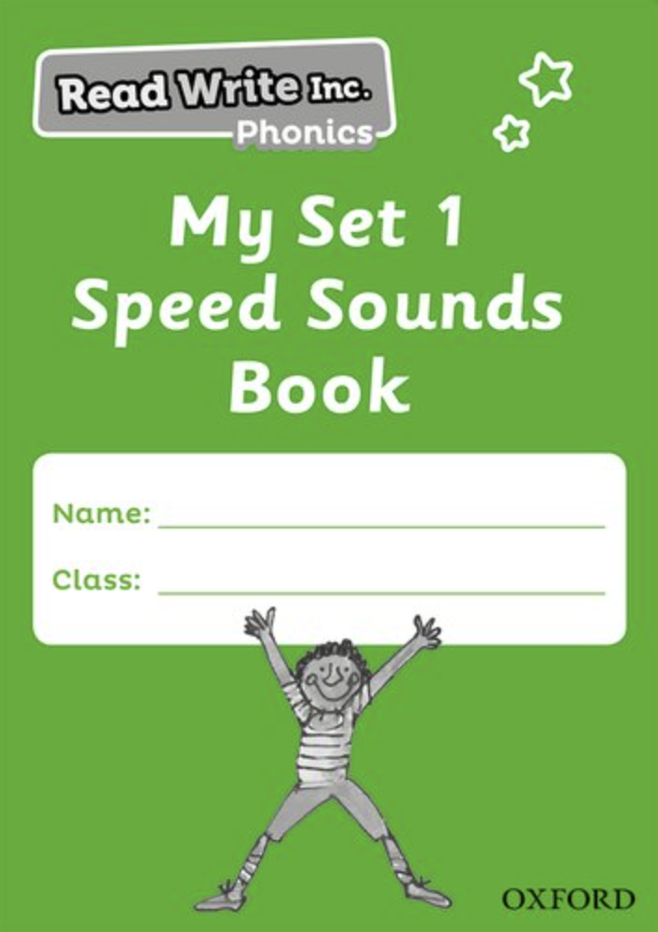
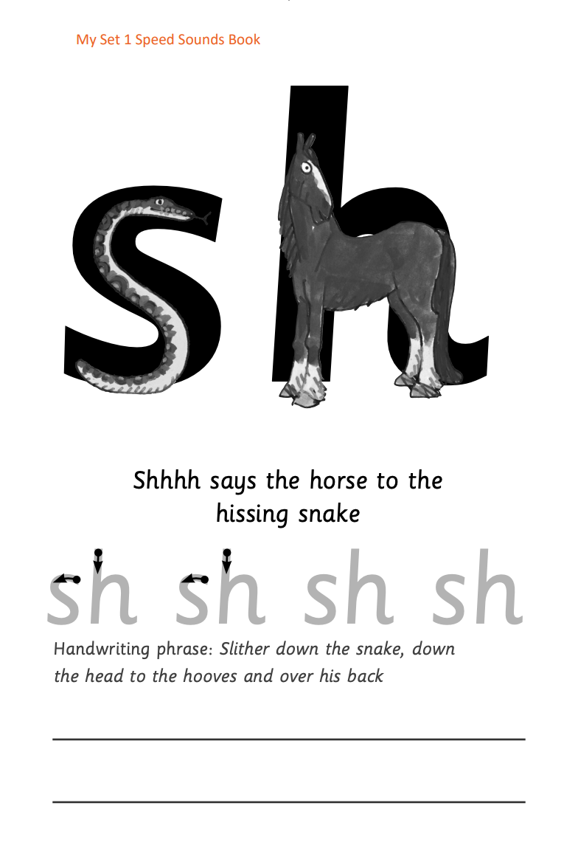






Practice at home
Notes:
Discuss the one that is applicable to your school:
Your child will also bring home a My Set 1 Speed Sounds books to practise reading and writing the Set 1 sounds
There are instructions for you inside cover of the book.
Each week, your child will bring home the Speed Sounds cards they have been taught to practise reading sounds speedily.
You can purchase Set 1 flashcards or My Reading and Writing Kit ages 3-5 early sounds and blending to support your child with Set 1 sounds at home if you wish.

Slide 17
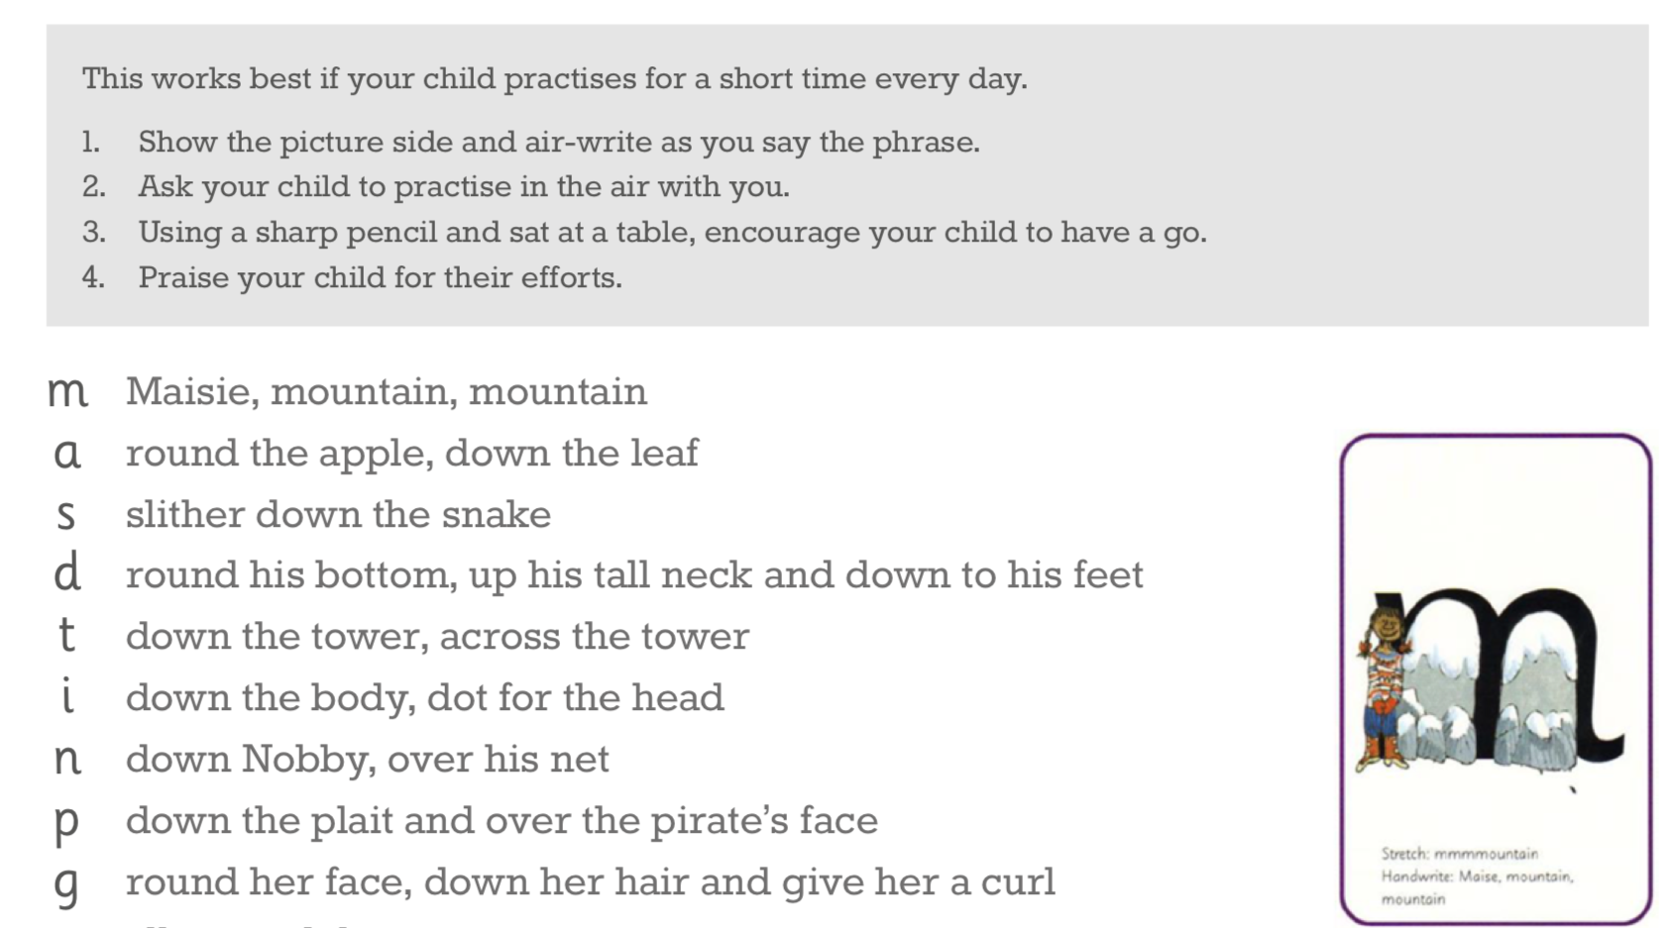
Teaching letter formation
Notes:
Alongside learning to read each sound, children use a handwriting phrase linked to the picture mnemonic to learn to form each letter correctly.
e.g. down Maisie, and over the mountains.
Use these handwriting phrases when practising writing at home with your child.
Avoid using these to read the sound.
I will give you a handout of these handwriting phrases when you leave today.

Slide 18

What can I do?
Use pure sounds rather than letter names.
Teach the picture names.
Practise reading sounds speedily.
Watch the Virtual Classroom films together.
Use the handwriting phrases to practise writing.
Notes:
1. Use pure sounds rather than letter names.
2. Teach the picture names.
3. Practise reading sounds speedily.
4. Watch the Virtual Classroom films together.
5. Use the handwriting phrases to practise writing.

Slide 19
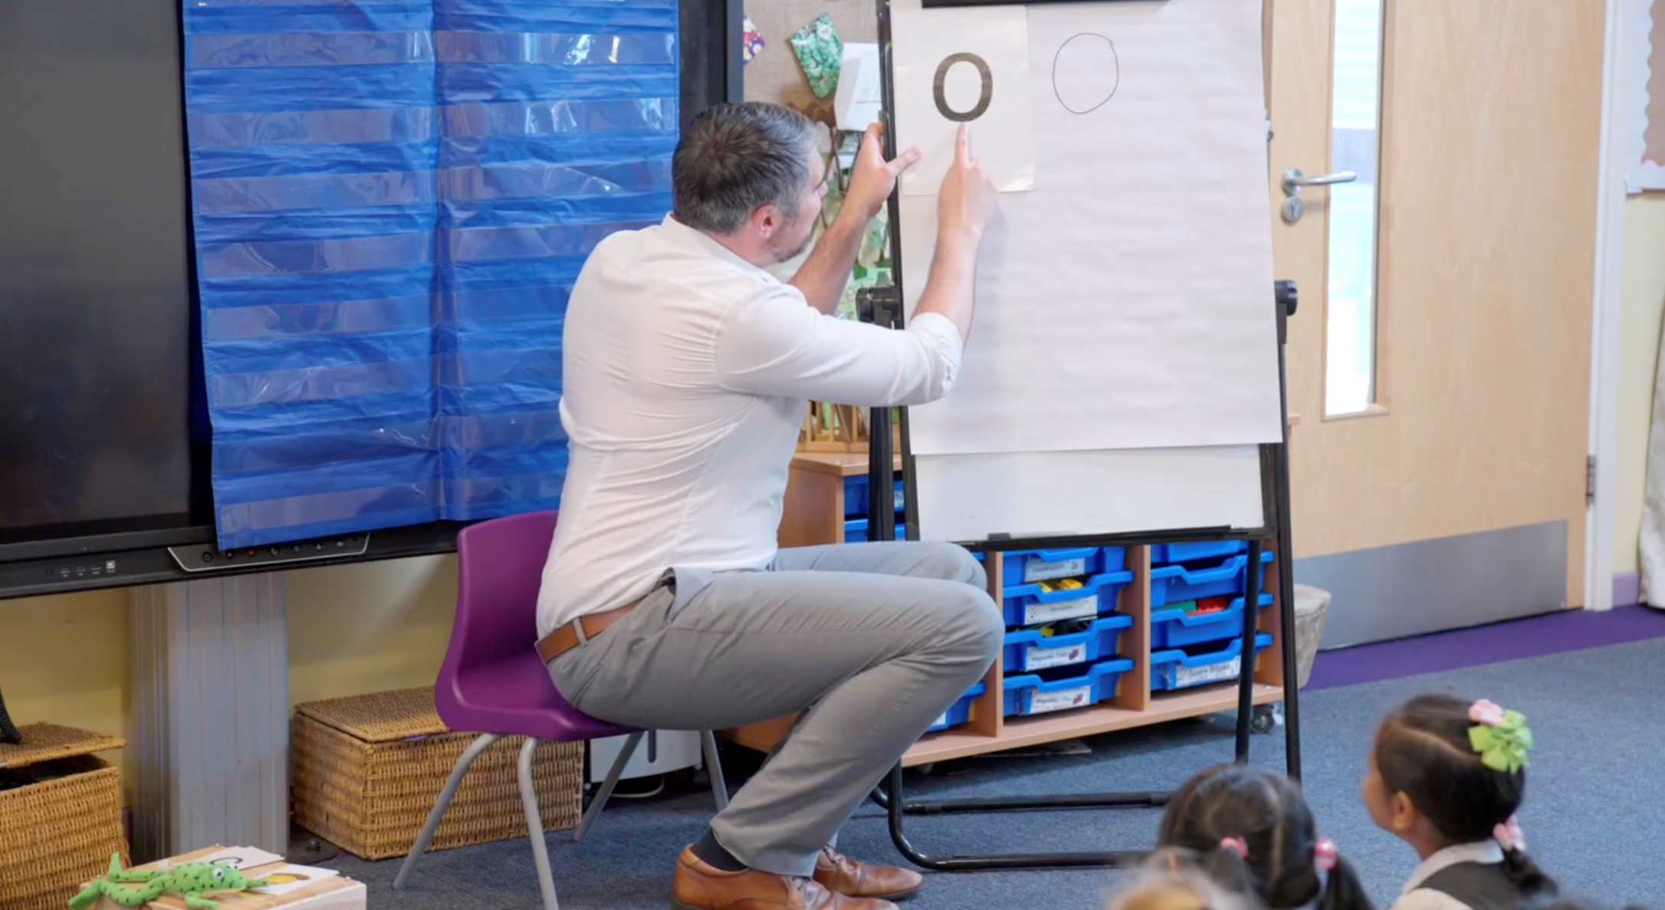
Teaching a Set 1 sound
Notes:
Demonstrate teaching a Set 1 sound to a group of children.
Alternatively, you may wish to use an in-action film from the School Portal.

Slide 20
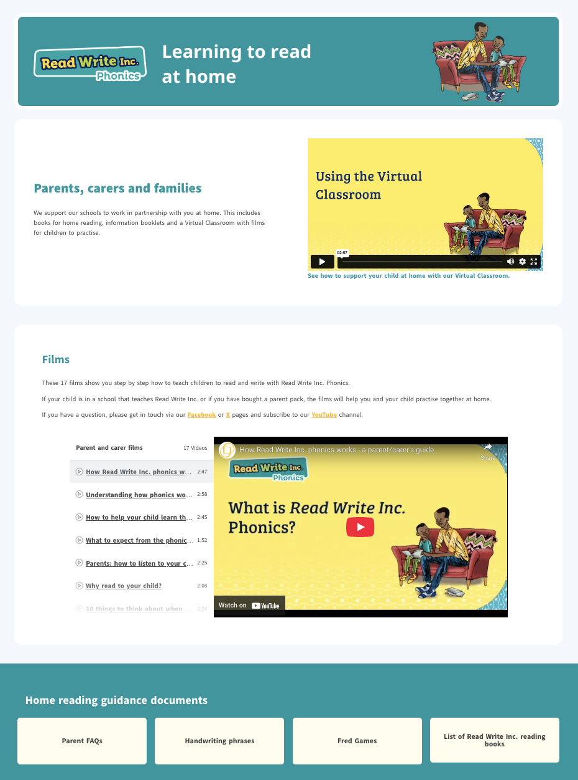
ruthmiskin.com
Notes:
Watch these video tutorials on the Ruth Miskin website to find out more about the PSC:
Understanding Phonics
The Phonics Screening Check
Using the Virtual Classroom

Slide 21

Online resources available
Ruth Miskin Families Page:
https://www.ruthmiskin.com/parentsandcarers/
Ruth Miskin Facebook:
https://www.facebook.com/miskin.education
Free e-books for home reading:
http://www.oxfordowl.co.uk/Reading/

Slide 22
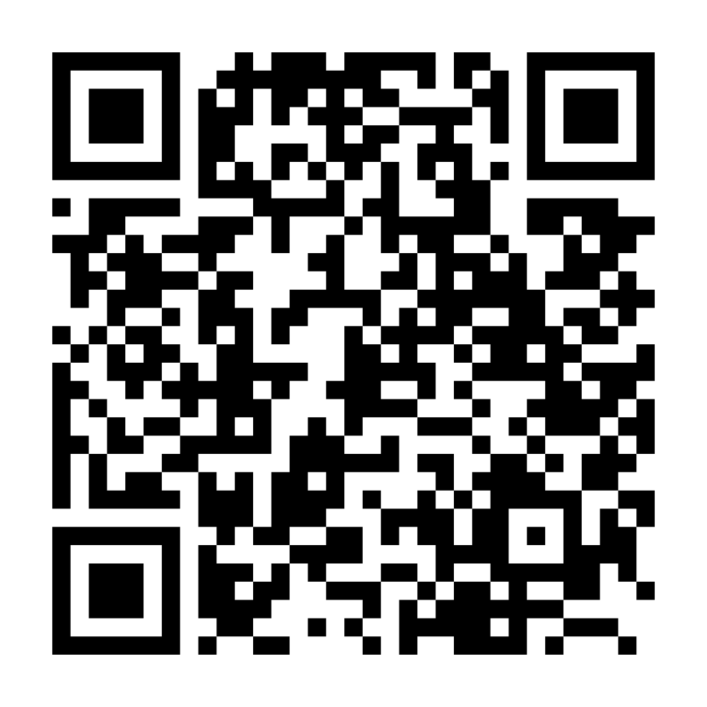

Parents carers and families webpage

Slide 23

Any questions?

Slide 24
Teach a child to read and keep that child reading and we will change everything.
And I mean everything.
Jeanette Winterson
Notes:
Remember that all parents have the power to change outcomes for their children.

