Slide 1

Parent Meeting Fred Talk
Notes:
Approximately 20 minutes is needed for this session.
Notes are provided to help you lead the presentation.
Notes in italics are for your attention only.
This bitesize parent session is best used alongside a demo of a Fred game in action with a group of children; an in-action film from the Online Subscription or playing a Fred Game with the parents.
Provide copies of ‘Reading at Home Booklet 1’ from Oxford Owl and Fred Games list for each parent.

Slide 2
Teach a child to read and keep that child reading and we will change everything.
And I mean everything.
Jeanette Winterson
Notes:
Read quote.

Slide 3

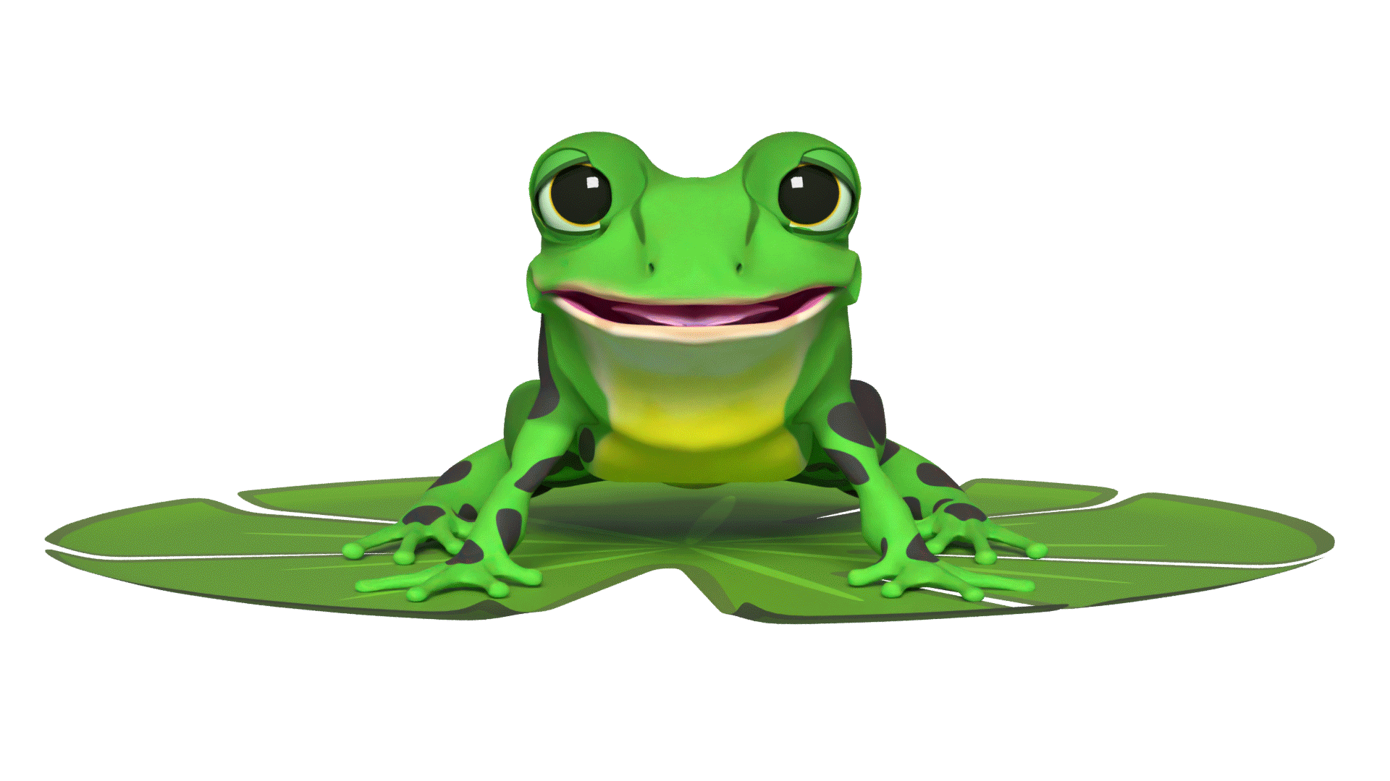

Speedy sounds + Fred = decoding
Notes:
Today I want to help you understand how your child is learning to read words in Read Write Inc. Phonics by blending sounds together.
Alongside teaching children the Set 1 sounds, we teach them to blend sounds to read words e.g. s-a-t, sat.
Once children can read sounds speedily, like this, (show how speedily this needs to be) and understand Fred (m-a-t...mat) (click), they can decode words.

Slide 4
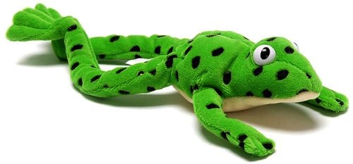
Make friends with Fred!
Notes:
Let me introduce you to Fred.
Fred helps children learn to blend sounds into a word.
Fred can only speak in sounds. He says d-o-g, h-a-t etc.
He says the sounds c-a-t, and then children help him to say the word.
This is how we quickly teach all of our children to blend orally.
We practise blending orally so children will find word-reading easier.

Slide 5
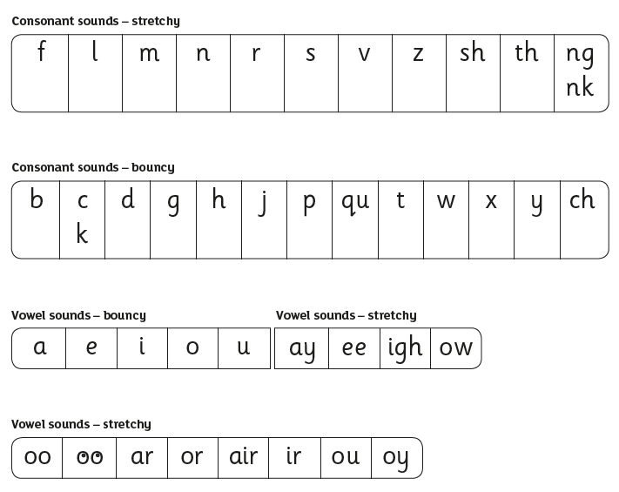
Speed Sounds Set 1
Notes:
Remember that:
children need to know sounds – not letter names – to read words
we say the sounds in a way to make them easy to blend into a word (‘m’ not’ muh’, ’s’ not ‘suh’, etc)
We aim to eliminate the ‘uh’ at the end of the sound. This is called a ‘schwa’ sound. This makes it easier to blend sounds into word.

Slide 6
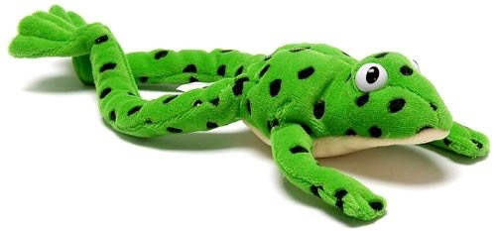

Fred Talk Routine
Say the word in sounds e.g. c-a-t.
Ask the child to repeat.
Can they ‘jump-in’ with the whole word?
Say the word in sounds followed by the whole word e.g. c-a-t, cat.
Ask the child to repeat.
Notes:
Fred Talk follows a consistent routine:
We say the word in sounds as Fred e.g. c-a-t. Ask children to repeat.
We pause to allow children to ‘jump-in’ with the whole word.
Say the word in sounds followed by the whole word e.g. c-a-t, cat. Ask children to repeat.

Slide 7
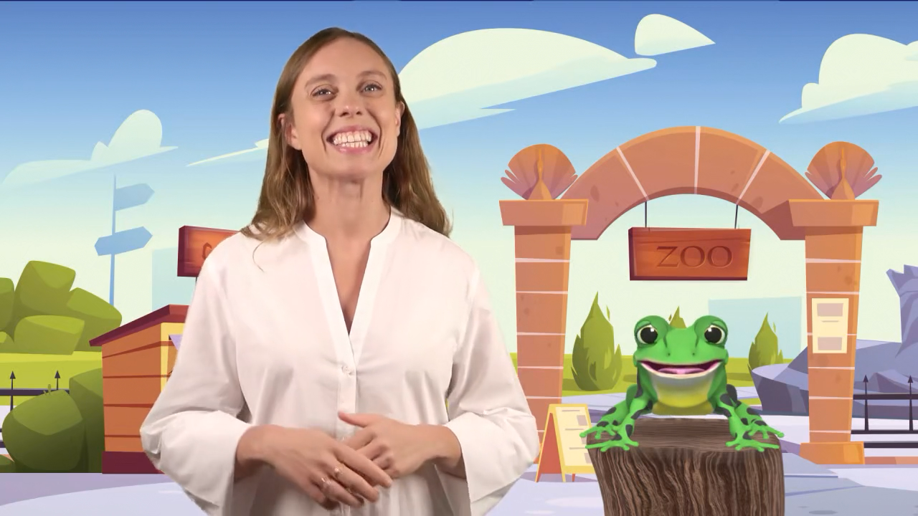
Virtual Classroom Fred Games
Notes:
Each week, we will send home film links or QR codes to lessons that match the sounds and words your child has been learning in school.
Simply click the link or scan the QR code and watch on a tablet or other device.
Let’s have a look at one of these Fred Games on the Virtual Classroom.

Slide 8

How do I use the Virtual Classroom?
Set aside 10 minutes to watch a film with your child each day.
Find a quiet space for your child to watch the film on a laptop or tablet.
Praise your child as they join in with the lesson – make it fun!
The more they practise using these films, the quicker they’ll learn to read.
Notes:
We will send you links to the films via email/ upload links to Google classroom/ Class Dojo etc.
When you receive the link, simply click on it . . . and press play.
Set aside 10 minutes to watch a film with your child each day.
Find a quiet space for your child to watch the film on a laptop or tablet.
Praise your child as they join in with the lesson – make it fun!
The more they practise using these films, the quicker they’ll learn to read.

Slide 9
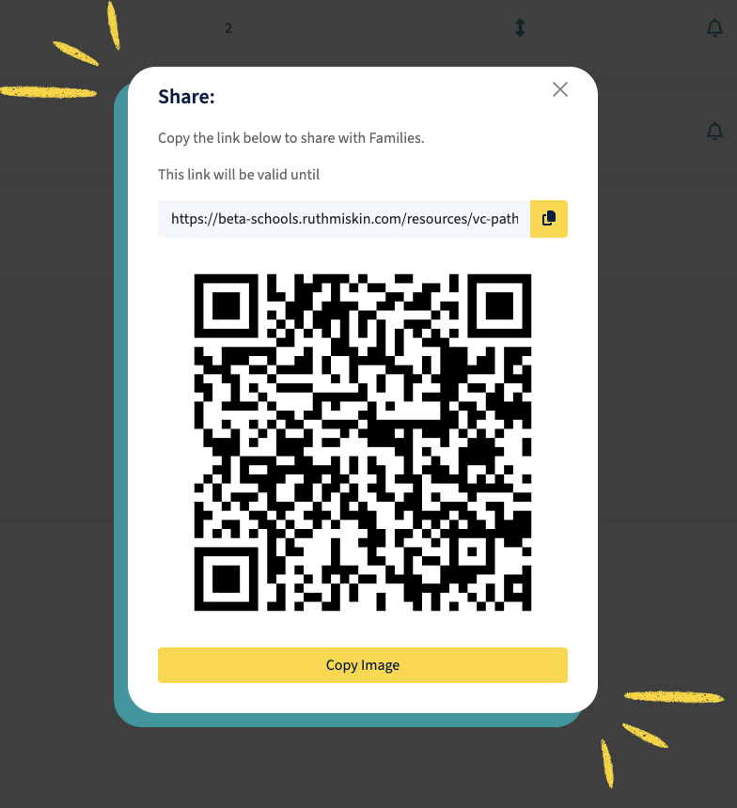
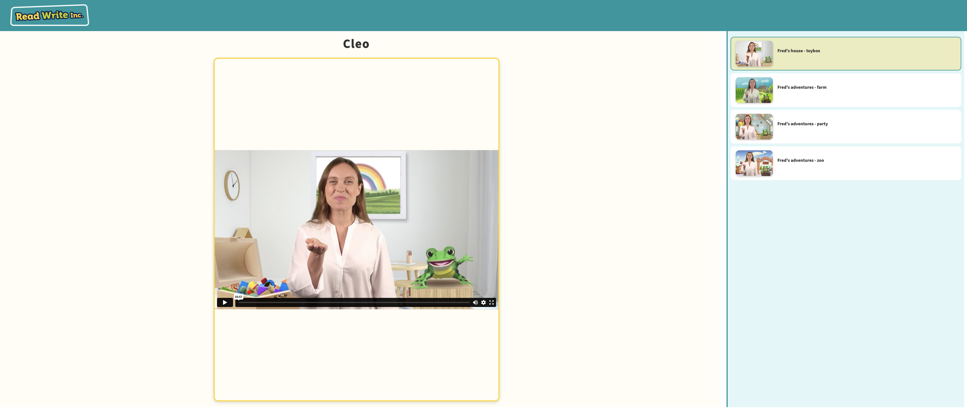
Pupil pathways

Slide 10
Fred Talk throughout the day
Shall we have some
What would you like to
Let’s put on your
-ch
l
-n
-u
?
-ay
-l
p
?
-oa
-t
c
.
Notes:
Try to use Fred Talk throughout the day at home to help your child practise orally blending sounds.
Fred Talk words at the end of the sentence and keep the words short and simple.
With the person next to you, have a practise of the three sentences on the screen.
Remember to Fred Talk the last word of the sentence.
You might like to play Fred Games with your child too!

Slide 11




Reading with Fred Talk
Notes:
Once children know their Set 1 sounds and can orally blend, we teach children to read words using Fred Talk e.g. m-a-t, mat.
We say ‘Fred Talk, read the word’.

Slide 12
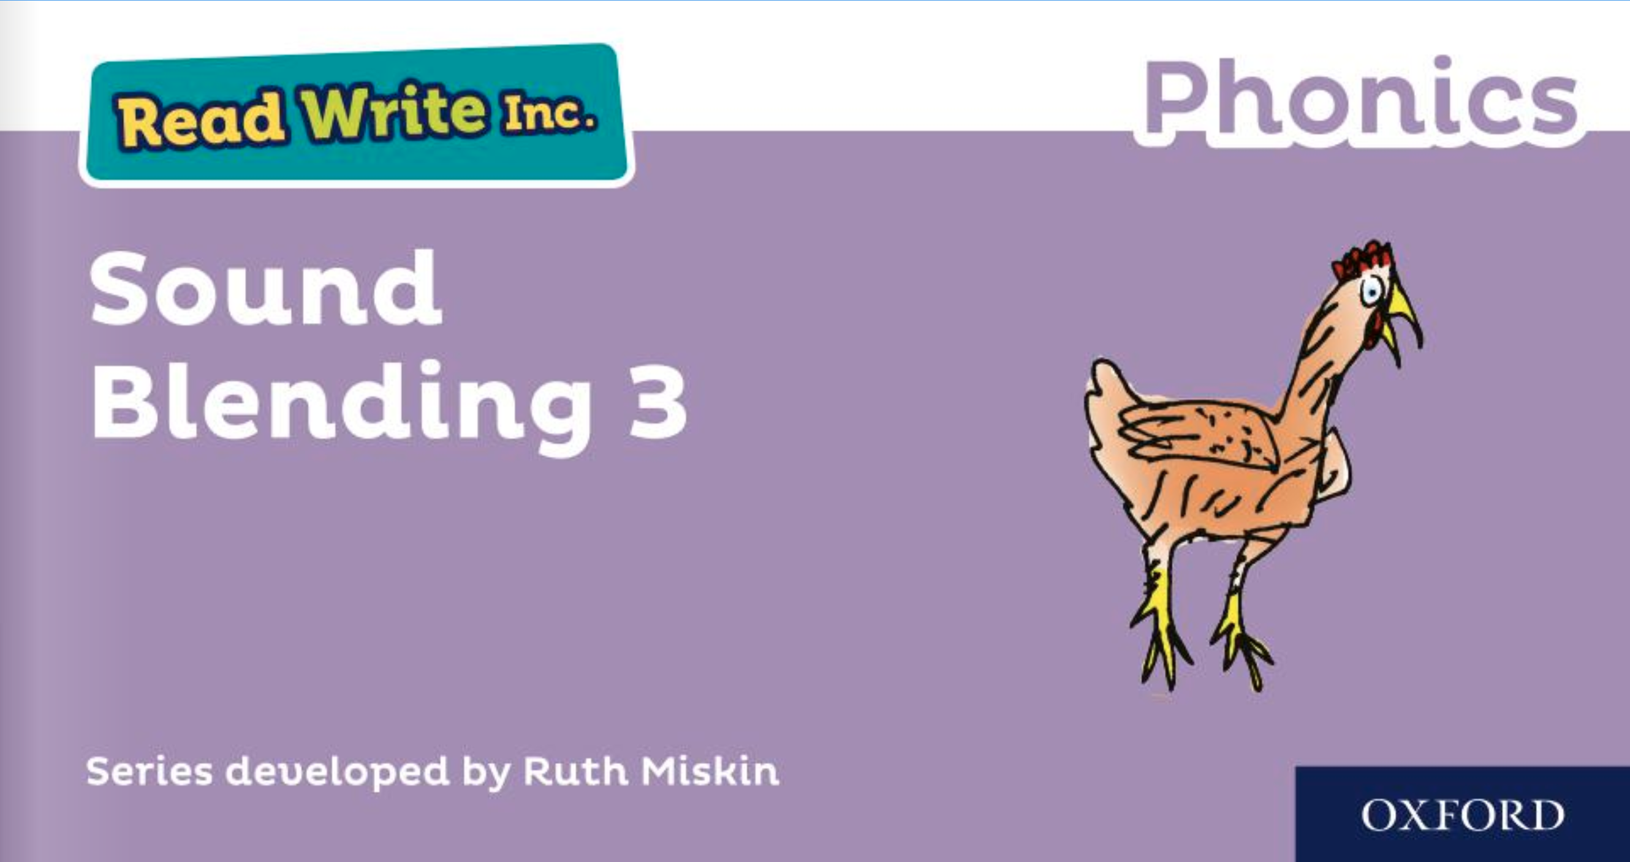
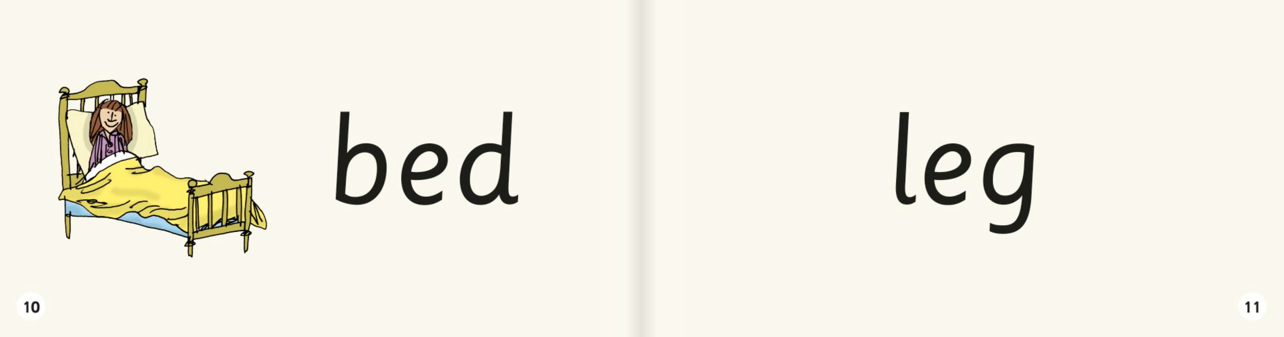
Sound blending books
Notes:
Once your child can blend the sounds they know to read words, they will bring home a sound blending book to practise reading words
Children love reading the word and then using the picture to check if they are right.

Slide 13
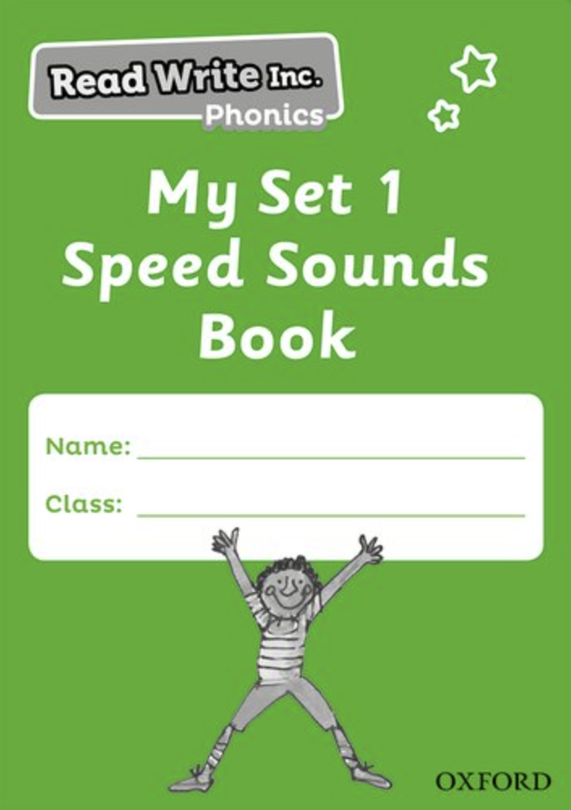
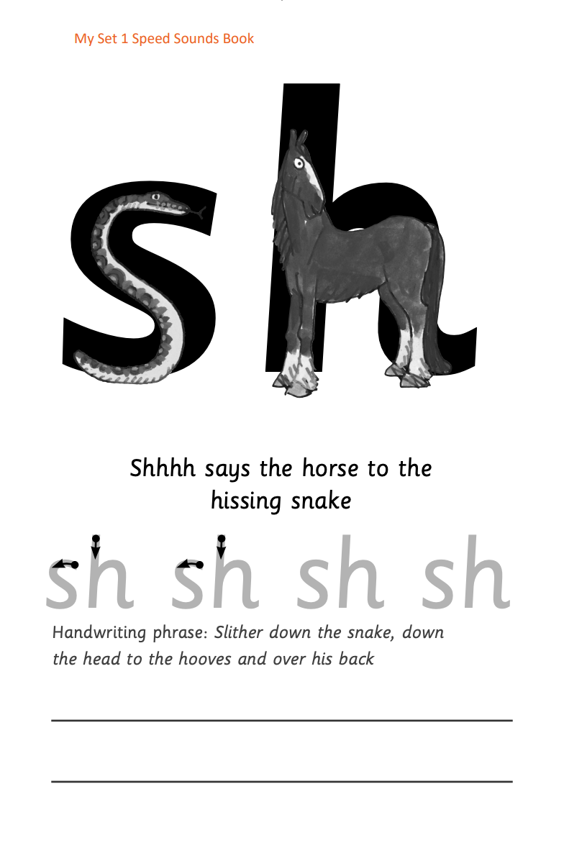



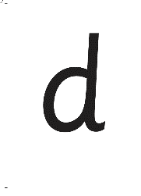


Practice at home
Notes:
Discuss the one that is applicable to your school:
Your child will also bring home a My Set 1 Speed Sounds books to practise reading and writing the Set 1 sounds
There are instructions for you inside cover of the book.
Each week, your child will bring home the Speed Sounds cards they have been taught to practise reading sounds speedily.
You can purchase Set 1 flashcards or My Reading and Writing Kit ages 3-5 early sounds and blending to support your child with Set 1 sounds at home if you wish.

Slide 14

What can I do?
Speak like Fred throughout the day.
Play Fred games.
Use Fred Talk to read words.
The sooner your child can orally blend, the sooner they will be able to read words.
Notes:
Give handout of Fred Games and Reading at Home Booklet 1’ to parents.
You can purchase Set 1 flashcards or My Reading and Writing Kit ages 5-7 more sounds and blending to support your child with blending at home.

Slide 15
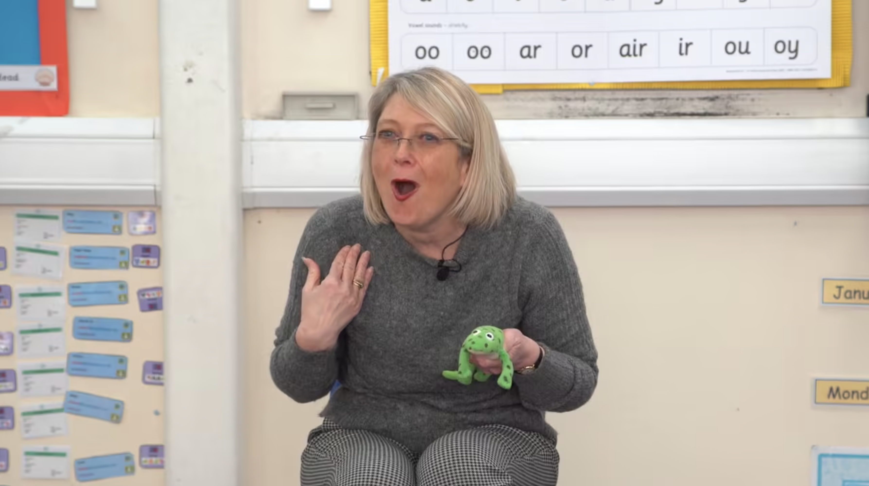
Fred Games
in-action
Notes:
Demonstrate teaching a Fred Game to a group of children/ parents as children.
Alternatively, show an in-action film of a Fred Game from the Online Subscription.

Slide 16

Online resources available
Ruth Miskin Families Page:
https://www.ruthmiskin.com/parentsandcarers/
Ruth Miskin Facebook:
https://www.facebook.com/miskin.education
Free e-books for home reading:
http://www.oxfordowl.co.uk/Reading/

Slide 17
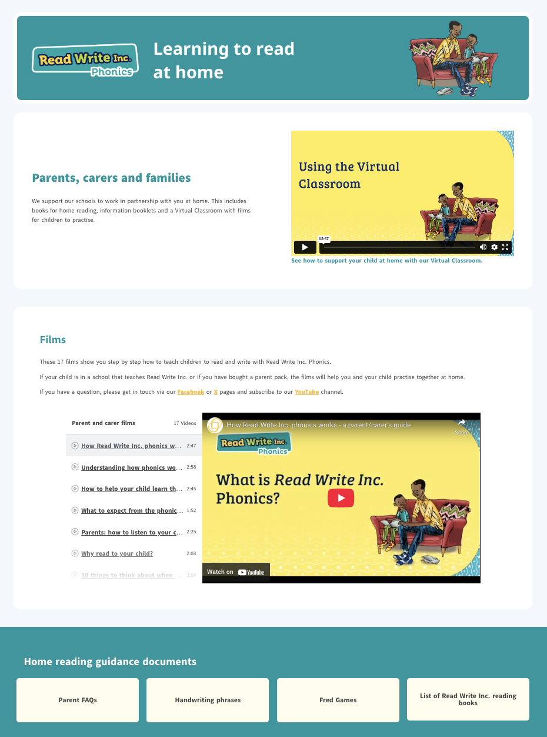
ruthmiskin.com
Notes:
Watch these video tutorials on the Ruth Miskin website to help your child to practise sound blending and reading words with Fred Talk at home:
Sound-blending
Blending sound books
There is also a handy ‘Using the Virtual Classroom’ film.

Slide 18
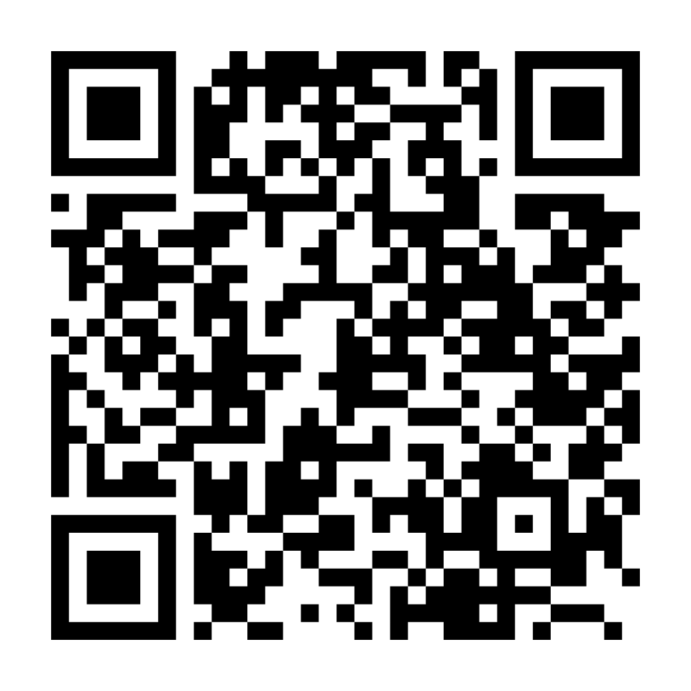

Parents carers and families webpage

Slide 19

Any questions?

Slide 20
Teach a child to read and keep that child reading and we will change everything.
And I mean everything.
Jeanette Winterson
Notes:
Read quote.

