Slide 1

Morton Trentside
Pre-school Welcome Meeting

Slide 2
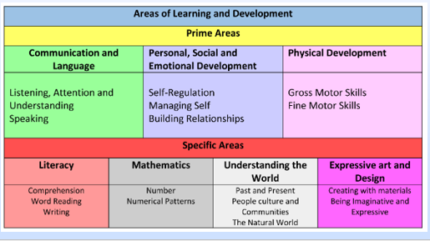
Early Years Foundation Stage

Slide 3


Characteristics of Effective Learning
Playing and exploring - children investigate, experience things and ‘have a go’.
Active learning - children concentrate, keep on trying if they encounter difficulties and enjoy achievements.
Creating and thinking critically - children have and develop their own ideas, make links between ideas, and develop strategies for doing things.

Slide 4
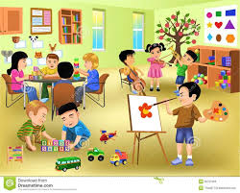

How our Classroom works
The classroom is divided into separate areas to enable us to meet all the areas of learning.
The children have access to inside and outside the classroom throughout the day, as well as timetabled opportunities to use the main playground, trim trail and tyre park.
The classroom is also used by our Reception children however, they have separate inputs and join us during child-initiated learning.
There are lots of adults in our classroom who are always on hand to help.

Slide 5

What do children need for school every day?
School uniform
PE kits (come to school wearing it on PE days)
Book Bags (these will be provided at the transition sessions)
Reading books and reading records
Water bottle (named)
Change of clothes to keep on peg (including socks and shoes)
Lunch box (if not ordering from school)

Slide 6


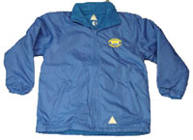
School Uniform
Please label all clothing with your child’s name
Grey trousers, skirt or pinafore dress and royal blue cardigan or sweatshirt (with logo)
White polo/t-shirt
Black shoes
In Summer, girls may wear blue/white dresses.
Jewellery, other than stud earrings for pierced ears should not be worn.
A suitable coat for wet weather conditions.

Slide 7
PE Kit
Please label all clothing with your child’s name
Navy shorts or joggers
White t-shirt
Trainers
For reasons of Health and Safety earrings should be removed for PE before school and long hair should be tied back.

Slide 8

Snacks
Fruit is provided for all children daily up to the end of Y2. Children may bring their own if they would prefer.
Milk is provided for free until children turn 5. After this point, there is a charge which can be arranged via the office.

Slide 9
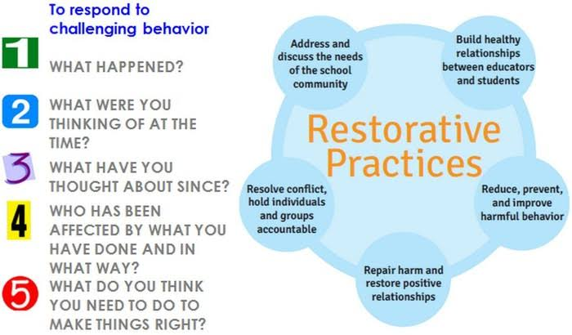
Rules and Behaviour
No Hurts Be Friends Have Fun

Slide 10


Keep updated with school news and events
School Website information
- Calendar
- Class pages
Facebook
Parent Hub

Slide 11

Tapestry – Online Learning Journal
Download the Tapestry App
Parent guide is on the school website
Staff will upload one observation a week which will be linked to your child’s learning and next steps.
As parents, you can also upload WOW moments from home.

Slide 12

School Transition Visits
Tuesday 1st July 11:30 – 13:00
All EYFS children are invited in for lunch at 11:30 with one family member. The classrooms will then be open for children to explore and meet their new peers. (please provide your order by Tuesday 24th June 2025)
Wednesday 9th July 13:30 – 14:30
All EYFS children are invited to come and play without parents. Drop off and pick up from the blue gates next to the main reception.

Slide 13
Thursday 4th September
Morning session 09:00 – 12:00 (optional lunch 12:30)
Afternoon session 12:30 – 15:30
Full day 09:00 – 15:30

Slide 14
Starting School
Doors open at 08:50am.
Drop off and pick up at the blue gate next to reception.
In the morning, say goodbye to your child at the gate and allow them to walk into school independently.
At the end of the day, collect your child from the blue gate. Please wait patiently for your child to come out to you. We will only let them leave the building once you arrive.
Please let the teacher or office staff know if somebody different is picking up your child.

Slide 15
Keep us updated
Inform a member of staff who is collecting your child if it is not who usually collects them.
Let us know of any change of phone number or email address.
Please don’t hesitate to contact us if you have any questions.
Laura.Frecknall@mortontrentside.lincs.sch.uk
Amy.Lindsay@mortontrentside.lincs.sch.uk
Sarah.scott@mortontrentside.lincs.sch.uk
Enquiries@mortontrentside.lincs.sch.uk

Slide 16
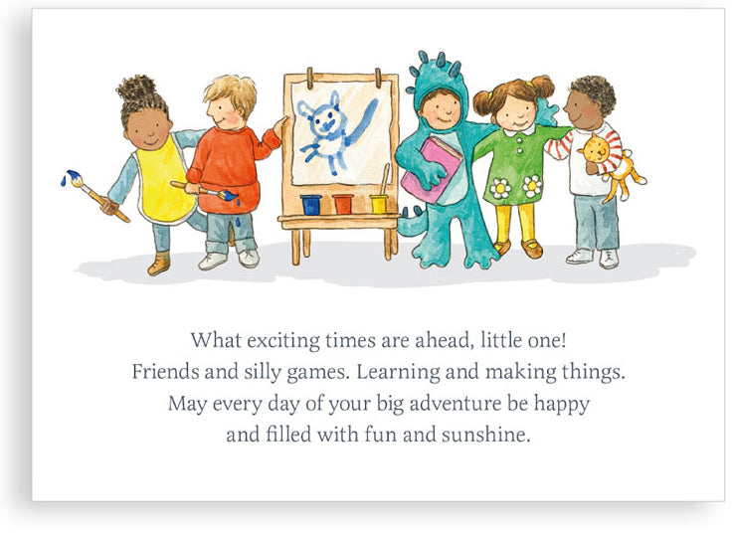
We can’t wait for you to join us!

